Slide 1

Operating System Management Process Scheduling, Memory Allocation & I/O Operations
CSA0401 – Operating systems
SUBMITTED BY:
SOBITHA D
192571046
Guided By:
Dr. J. RUBY ELIZABETH

Slide 2
Introduction to Operating System
An Operating System (OS) is system software that acts as an interface between users, applications, and computer hardware.
Main Responsibilities:
Process management
Memory management
File management
Input/Output (I/O) management
Security and resource allocation
Example: Windows , Linux

Slide 3
OPERATING SYSTEM FUNCTIONS
Resource Sharing: Multiple users and programs can share CPU, memory, and devices.
Concurrency Control: OS manages simultaneous execution of processes.
Deadlock Handling: Detects or prevents processes from waiting forever.
Interrupt Handling: Responds to hardware and software interrupts quickly.
Error Detection: Identifies and handles hardware or software failures.

Slide 4

Process Scheduling
Process Scheduling is the mechanism used by the Operating System to select which process from the ready queue should get the CPU for execution next.
Key Components:
Long-Term Scheduler (Job Scheduler):
Short-Term Scheduler (CPU Scheduler):
Medium-Term Scheduler
Dispatcher

Slide 5
ALGORITHMS
First-Come, First-Served (FCFS)
Shortest Job First (SJF)
Round Robin (RR)
Priority Scheduling
Multilevel Queue

Slide 6
Memory Allocation
Memory Allocation is the process by which the Operating System assigns portions of main memory (RAM) to processes and programs for execution.
Memory Allocation
Static Allocation
Dynamic Allocation

Slide 7
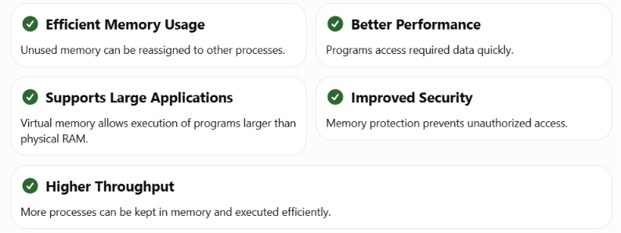
Benefits of Memory Allocation

Slide 8
I/O Operation Management
I/O (Input/Output) Operation Management is the function of the Operating System that controls and coordinates data transfer between the CPU, memory, and external devices such as keyboards, disks, printers, and network interfaces.
System Call
open()
read()
write()
close()
ioctl()
select()/poll()
Examples
Keyboard
Mouse
Hard Disk / SSD
Printer
Monitor
Network Adapter

Slide 9
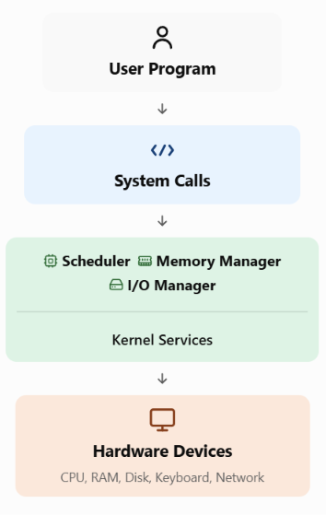
Interaction Between OS Components
System Calls Used:
open() – open video file
read() – read video data
mmap() – map file into memory
write() – send output to display/audio device
close() – close file

Slide 10
Conclusion
The Operating System efficiently manages process scheduling, memory allocation, and I/O operations to ensure better performance, multitasking, and reliable communication between software and hardware.
Process scheduling improves CPU utilization.
Memory allocation ensures efficient RAM management.
I/O management enables fast and reliable data transfer.
System calls connect applications with the OS kernel.

Slide 11
THANK YOU

